Slide 1
MINI PROJECT (U23ECW602) GUIDED BY: Dr.R.Kurinjimalar PROFESSOR
SRI MANAKULA VINAYAGAR
ENGINEERING COLLEGE
(An Autonomous Institution)
DEPARTMENT OF ELECTRONICS AND COMMUNICATION ENGINEERING
SELF-CALIBRATING SMART INDICATOR MODULE FOR CONVENTIONAL LATHE MACHINES WITHOUT MACHINE MODIFICATION
Presented by
GAYATHRI D
RUPAWAANI K
III/VI/D
Department of ECE

Slide 2

TABLE OF CONTENTS
Introduction
Objective
Problem Statement
Existing Solution
Working Principle
Block Diagram
Circuit Diagram
Components List
Novelty
SDGs and Domain Specifications
Future Scope
Conclusion
References

Slide 3
INTRODUCTION
Conventional lathe machines are widely used in small and medium manufacturing industries, but they rely heavily on operator experience to judge machine condition and tool health.
Lack of real-time indication of abnormal cutting conditions often leads to tool damage, poor surface finish, material wastage, and safety risks.
There is a need for a low-cost, external monitoring solution that can provide early warnings without modifying existing lathe machines.

Slide 4
OBJECTIVE
To design a self-calibrating smart indicator module that automatically learns normal machining conditions of a conventional lathe machine.
To develop a non-intrusive system that monitors vibration and sound signals without altering the machine structure or wiring.
To provide real-time visual and audible indications to alert the operator about abnormal machining conditions.

Slide 5
PROBLEM STATEMENT
Conventional lathe machines do not have built-in systems to indicate abnormal vibration, sound, or load during machining operations.
Existing monitoring solutions are either designed for CNC machines or require machine modification, making them unsuitable for small-scale workshops.
Fixed-threshold monitoring methods are unreliable due to changes in cutting speed, material, and operator handling.

Slide 6
EXISTING SOLUTION
Conventional lathe machines rely on experienced operators to identify abnormal sound and vibration manually during machining.
Advanced CNC machines use integrated sensors and control systems for real-time condition monitoring and fault detection.
External high-cost systems use vibration and acoustic sensors with advanced analysis techniques for machine health monitoring in large industries.

Slide 7
WORKING PRINCIPLE
The smart indicator module is placed externally near the conventional lathe machine, where vibration and sound sensors capture signals generated during machining.
When the system is powered ON, it enters a self-calibration phase in which it records sensor readings during normal machining to establish baseline reference values.
After calibration, the system continuously monitors vibration and sound signals while machining is in progress.
The microcontroller compares live sensor data with stored baseline values to detect any abnormal changes.
If the deviation exceeds normal limits, the system activates visual indicators (LEDs) and audible alerts (buzzer) to warn the operator.
The operator can then take corrective action such as adjusting cutting parameters or replacing the tool to prevent damage.

Slide 8
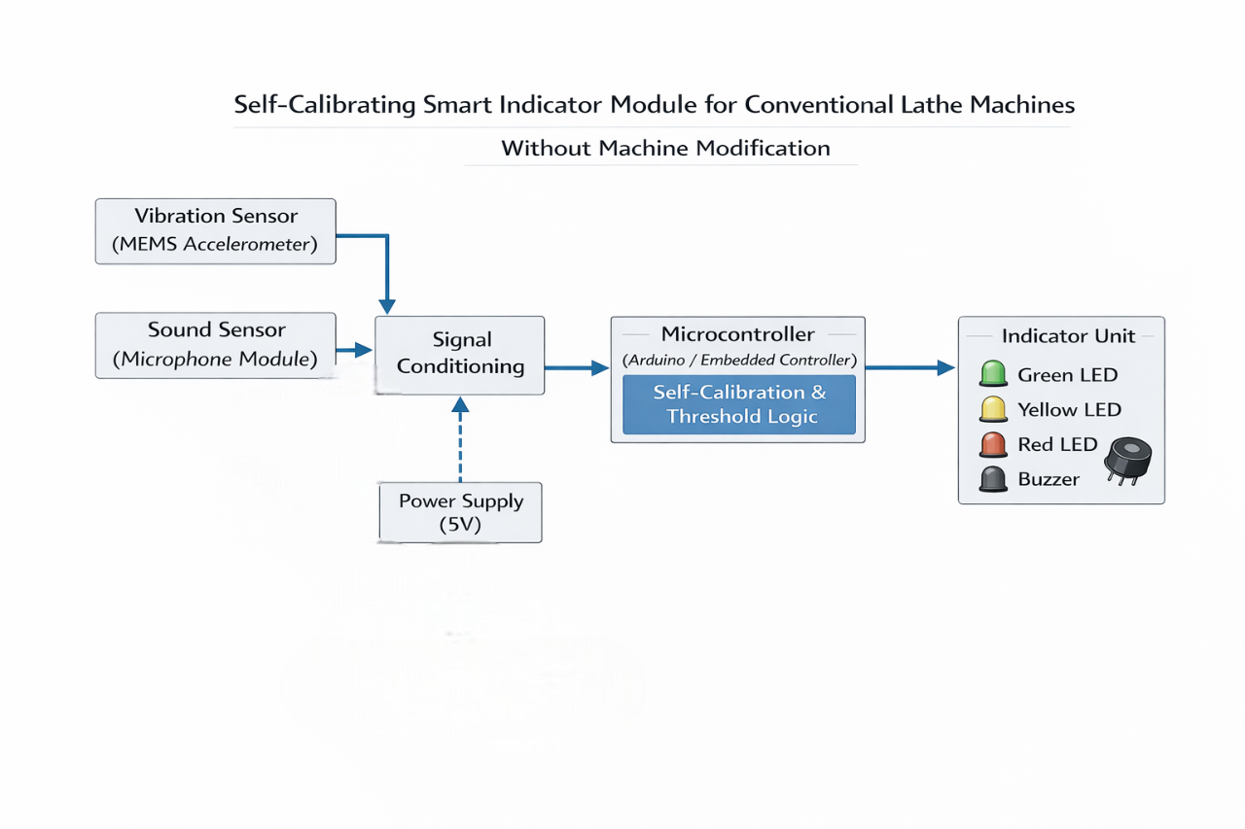
BLOCK DIAGRAM

Slide 9
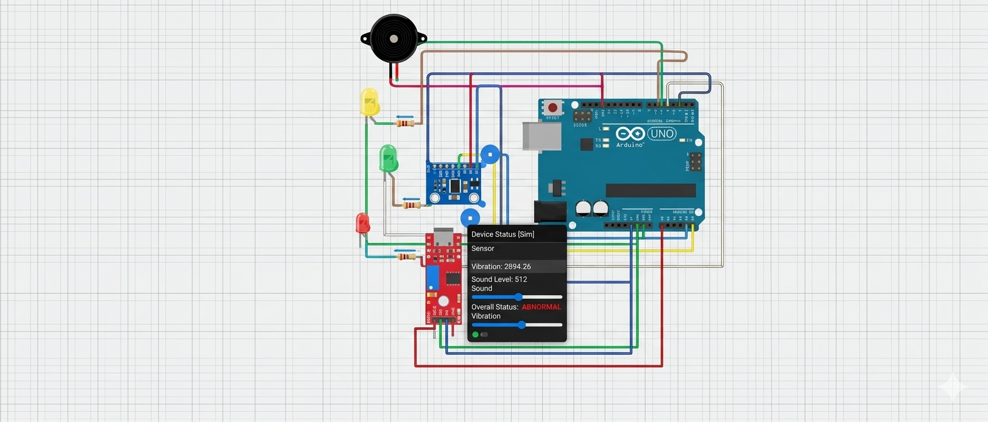
CIRCUIT DIAGRAM

Slide 10
COMPONENTS LIST
Component | Typical Cost (₹) | Notes
Microcontroller (Arduino Nano ) | 150–350 | Nano inexpensive and practical
MEMS Accelerometer (e.g., MPU-6050 / ADXL345) | 80–180 | Digital sensor for vibration
Sound Sensor Module (e.g., MAX9814 / KY-037) | 50–150 | With amplifier for audio detection
Signal Conditioning Op-Amp (LM358 or similar) | 20–50 | For clean sensor signal
LEDs (3 pcs: Green, Yellow, Red) | 10–30 | Standard 5 mm LEDs
Buzzer (Active Piezo) | 20–60 | Generates alert sound
Resistors & Capacitors | 20–50 | Passive parts for conditioning
5 V Power Supply (DC jack or USB) | 100–200 | Regulated power module
PCB + Connectors + Misc. | 100–250 | PCB fabrication + headers

Slide 11

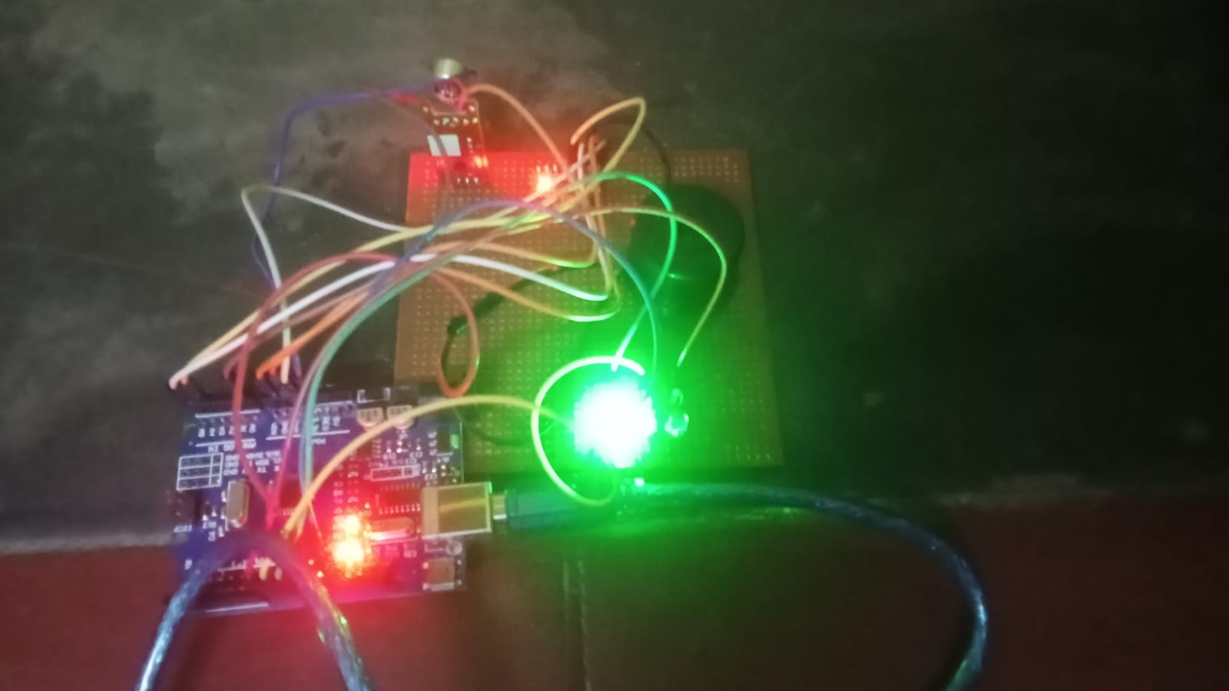
OUTPUT

Slide 12
NOVELTY
Non-intrusive design makes the system compatible with existing conventional lathe machines.
Low-cost, real-time indication improves operator safety, tool life, and machining quality.
Self-calibrating monitoring eliminates the need for manual tuning.

Slide 13
SDGs AND DOMAIN SPECIFIACTION
SDG 8 – Decent Work and Economic Growth The system gives early warning signals when something goes wrong, making the workplace safer and reducing machine breakdown time. This increases productivity.
SDG 9 – Industry, Innovation and Infrastructure This project provides a low-cost smart monitoring system that improves the performance of normal lathe machines without changing the existing setup.
SDG 12 – Responsible Consumption and Production The system detects tool and machine problems in real-time, which reduces material waste, tool damage, and unnecessary energy usage.
Core Domain : Embedded Systems

Slide 14
FUTURE SCOPE
• Integration with IoT for remote monitoring and real-time data logging through mobile or web applications.
• Implementation of machine learning algorithms for predictive maintenance and more accurate fault detection.
• Expansion of the system to support multiple machines with centralized monitoring in industrial environments.

Slide 15
CONCLUSION
• Developed a low-cost, non-intrusive smart monitoring system for conventional lathe machines.
• Successfully demonstrated real-time detection of abnormal vibration and sound conditions.
• Improved machine safety, tool life, and operational reliability through early warning indication.

Slide 16
REFERENCES
[1] S. Dimla Jr., “Sensor signals for tool-wear monitoring in metal cutting operations—a review of methods,” International Journal of Machine Tools and Manufacture, vol. 40, no. 8, pp. 1073–1098, 2000.
[2] T. I. El-Wardany, D. Gao, and M. A. Elbestawi, “Tool condition monitoring in drilling using vibration analysis,” International Journal of Machine Tools and Manufacture, vol. 36, no. 6, pp. 687–711, 1996.
[3] A. K. Tiwari, P. K. Saha, and A. D. Bhalerao, “Tool condition monitoring in turning using acoustic emission and vibration signals,” Measurement, vol. 46, no. 10, pp. 4061–4070, 2013.
[4] J. Tlusty and G. C. Andrews, “A critical review of sensors for unmanned machining,” CIRP Annals, vol. 32, no. 2, pp. 563–572, 1983.
[5] S. Salgado and F. Alonso, “Tool wear detection in turning operations using vibration analysis,” Journal of Materials Processing Technology, vol. 136, no. 1–3, pp. 110–116, 2003.

Slide 17
THANK YOU

